Slide 1
Remote-Controlled Sumo Robot Project by – Jean-Roland Dupuy
This Third-year project is a remote-controlled vehicle which also could be a Sumo bot. The design of the vehicle is to look like a sumo bot. There are two modes of operation for this product: the main mode is to control the vehicle remotely and the autonomous mode for sumo bot functionality. In both modes, a wireless connection to WIFI is required and a computer to operate/monitor the product.

Slide 2
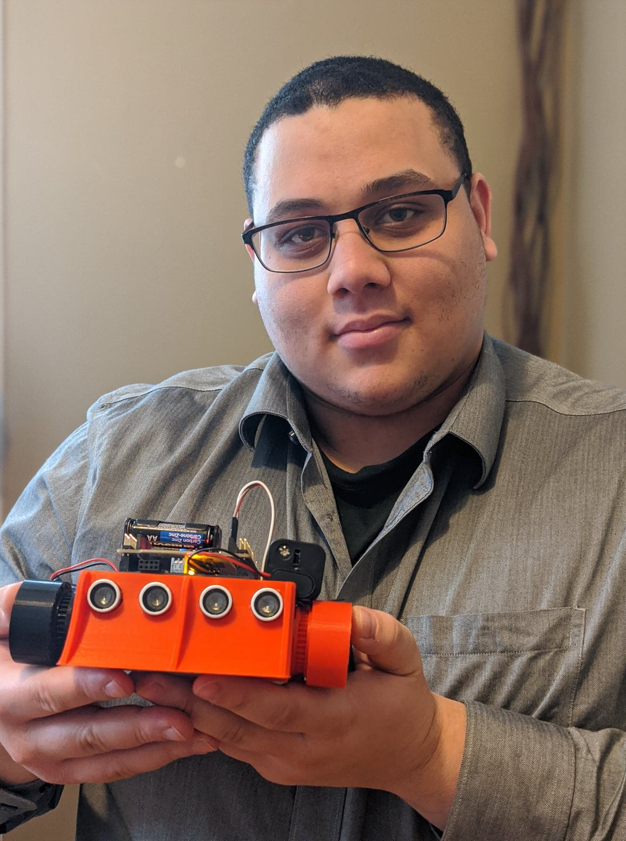

Slide 3
